Slide 1
Ferromagnetism
ECE 65800
04 / 13 / 2026
CheongEun Kim (kim3833@purdue.edu)

Slide 2
What Is Ferromagnetism?
Introduction
Ferromagnetism is a phenomenon in which atomic magnetic moments align parallel to each other, even without an external magnetic field.
This collective alignment produces spontaneous magnetization
Ferromagnetic materials can show a strong magnetic response and may remain magnetized after the field is removed.
Common Examples:
- Iron (Fe)
- Cobalt (Co)
- Nickel (Ni)
Key Features:
- Long-range spin order
- Strong magnetic response
- Magnetic memory

Slide 3

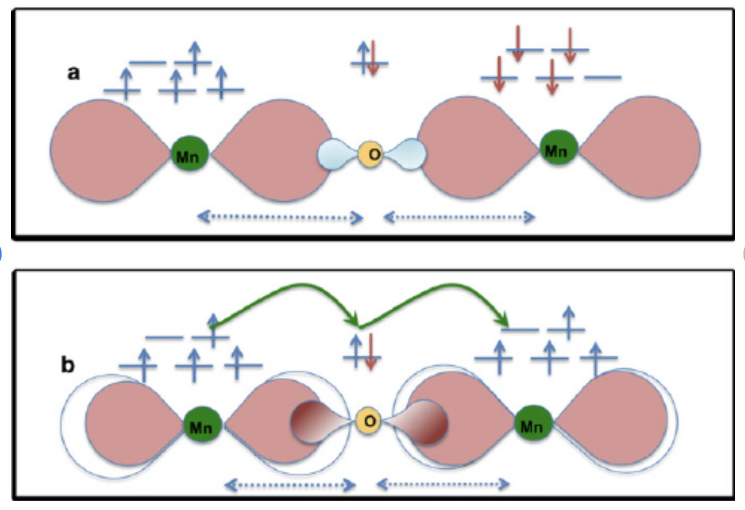
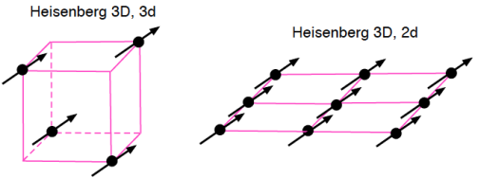
Microscopic Origin: Exchange Interaction
Subhead, Acumin Pro Cond 22
The microscopic origin of ferromagnetism is the exchange interaction.
This is a quantum mechanical effect related to electron wavefunctions and the Pauli exclusion principle.
In some materials, parallel spin alignment lowers the total energy, making ferromagnetic ordering favorable.
Common model: Heisenberg Hamiltonian Model
  Spins are treated as three-component vectors
  The lattice itself can be 1D, 2D, or 3D
In this sign convention, $J>0$favors parallel spin alignment.
[1]
Notes:
[1] A schematic picture showing (a) super exchange interaction favoring AFM coupling (b) and double exchange interaction favoring FM coupling between the Mn ions, which is mediated via the O ion lying in between. The blue dotted line shows the Mn-O interatomic distance in both cases. The green connecting curved line shows the simultaneous charge transfer between Mn and O atoms. Pink lobes around Mn atoms in both panel (a) and (b) and around O in panel b present the spin-polarized charge density, whereas the blue lobes around O in panel (a) present spin- unpolarized charge density. The blue and red arrows present the positive and negative spin densities, respectively.

Slide 4
Why Only Certain Materials?
Subhead, Acumin Pro Cond 22
Requires favorable exchange interaction
Depends on electronic and crystal structure
Interatomic spacing matters
Common in partially filled 3d systems

Slide 5
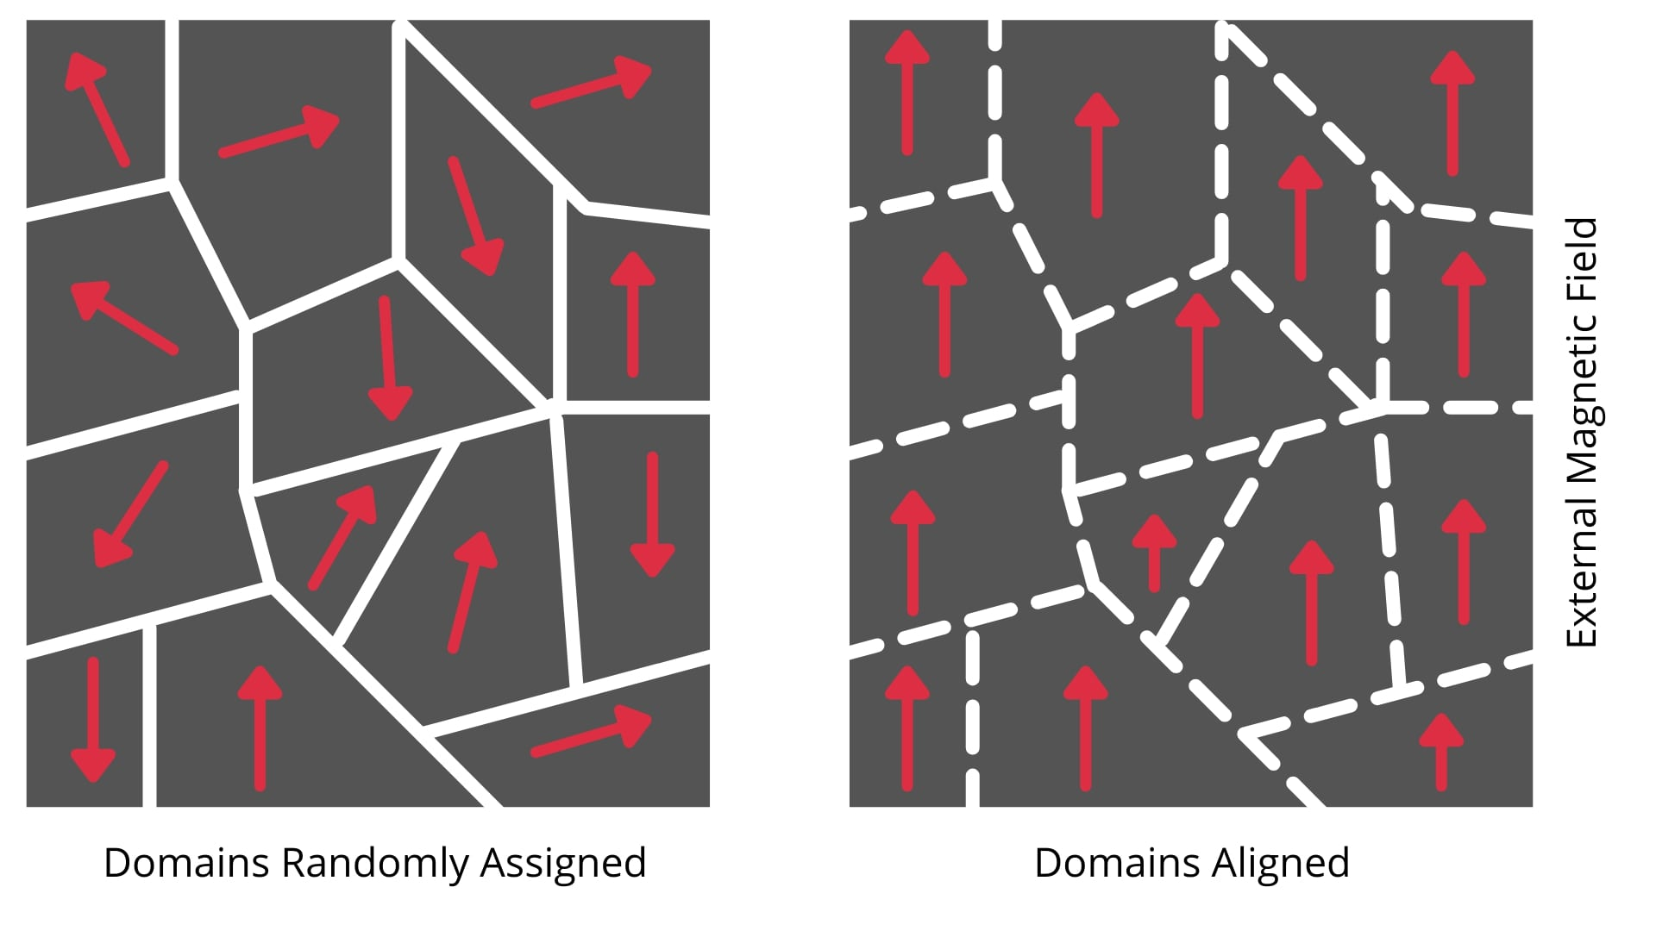
Magnetic Domains
Subhead, Acumin Pro Cond 22
Ferromagnetic materials are divided into small regions called magnetic domains.
Within each domain, magnetic moments are aligned in the same direction.
However, different domains may point in different directions, so the net magnetization can be small before a field is applied.
Domains form to reduce the total magnetic energy of the material.
Magnetization occurs mainly through:
  Domain wall motion
  Domain rotation
[2] Magnetic domains of a ferromagnetic material line up when exposed to an external magnetic field.

Slide 6
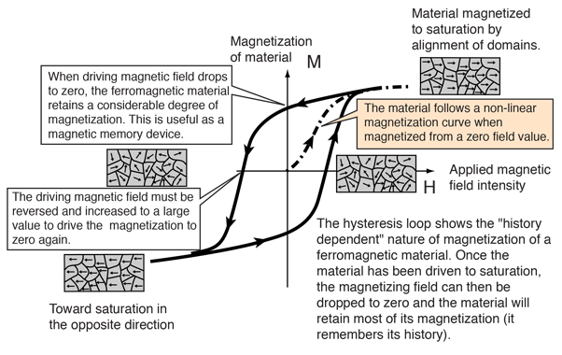
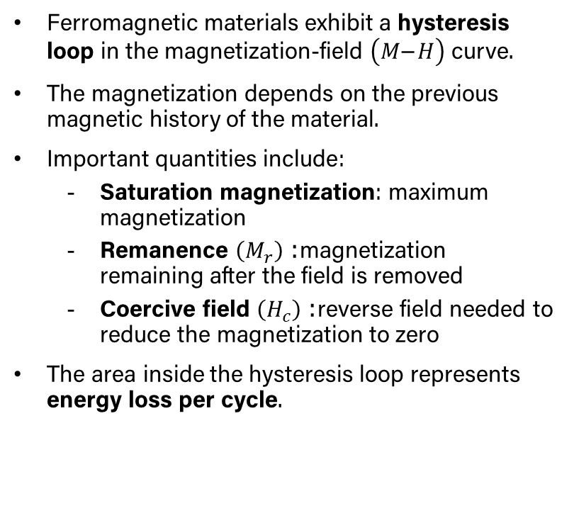
Hysteresis and Magnetic Memory
Subhead, Acumin Pro Cond 22
Ferromagnetic materials exhibit a hysteresis loop in the magnetization-field $\left(M\text{−}H\right)$ curve.
The magnetization depends on the previous magnetic history of the material.
Important quantities include:
  Saturation magnetization: maximum magnetization
  Remanence $\left(M_{r}\right)$: magnetization remaining after the field is removed
  Coercive field $\left(H_{c}\right)$: reverse field needed to reduce the magnetization to zero
The area inside the hysteresis loop represents energy loss per cycle.
[3]

Slide 7
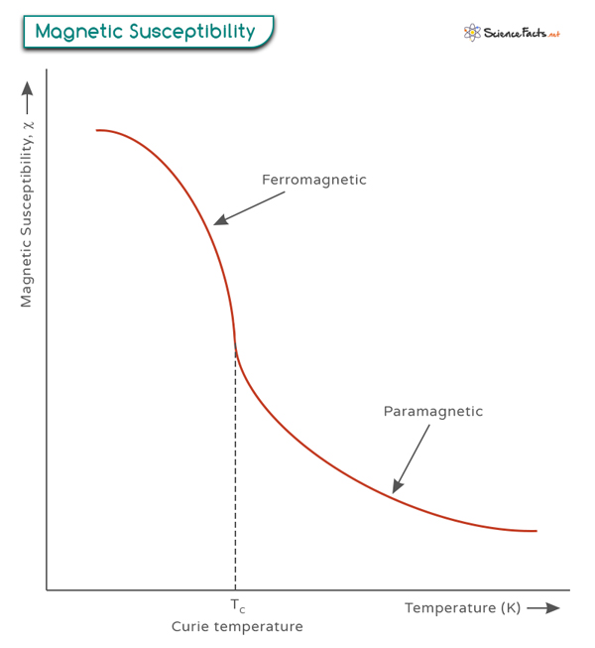
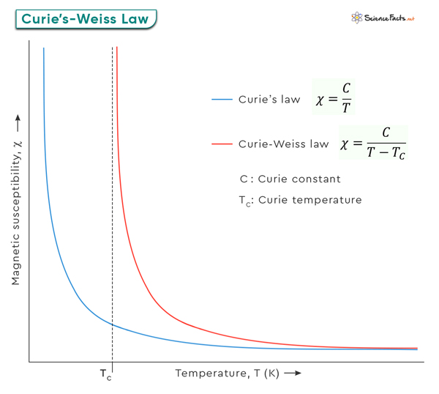

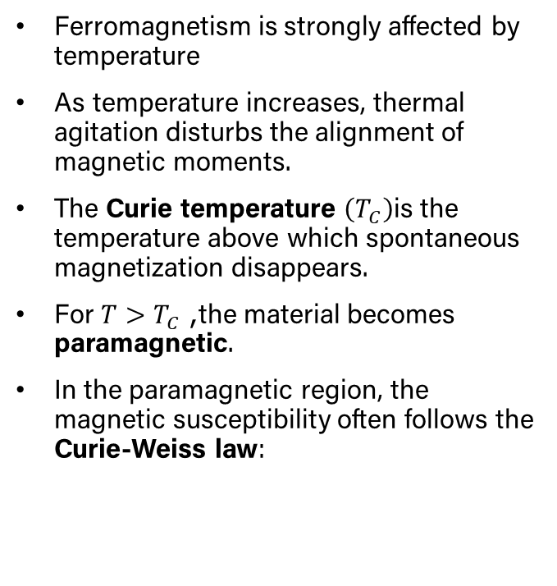
Curie Temperature
Subhead, Acumin Pro Cond 22
Ferromagnetism is strongly affected by temperature
As temperature increases, thermal agitation disturbs the alignment of magnetic moments.
The Curie temperature $\left(T_{C}\right)$is the temperature above which spontaneous magnetization disappears.
For $T>T_{C}$, the material becomes paramagnetic.
In the paramagnetic region, the magnetic susceptibility often follows the Curie-Weiss law:
[4]

Slide 8
Representative Ferromagnetic Materials
Subhead, Acumin Pro Cond 22
Classic ferromagnetic elements include:
  Iron (Fe)
  Cobalt (Co)
  Nickel (Ni)
In addition to pure elements, many alloys also exhibit strong ferromagnetic behavior.
Hard magnetic materials
Soft magnetic materials
Material choice depends on the intended application and magnetic performance requirements.

Slide 9
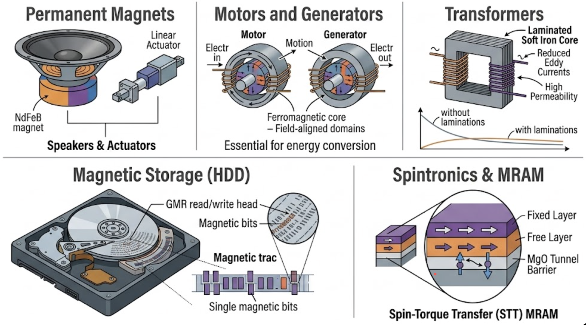
Applications of Ferromagnetism
Subhead, Acumin Pro Cond 22
Permanent magnets
  - Used in speakers, actuators, and many mechanical systems
Motors and generators
  - Essential for energy conversion and electromechanical devices
Transformers
  - Soft magnetic materials help reduce energy loss
Magnetic storage
  - Ferromagnetic materials enable data storage in hard drives and related technologies
Spintronics and MRAM
  - Used in advanced memory technologies

Slide 10
References
Subhead, Acumin Pro Cond 22
[1] Panigrahi, Puspamitra & Araujo, C. & Hussain, Tanveer & Ahuja, Rajeev. (2014). Crafting ferromagnetism in Mn-doped MgO surfaces with p-type defects. Science and Technology of Advanced Materials. 15. 035008. 10.1088/1468-6996/15/3/035008.
[2] https://eepower.com/technical-articles/understanding-the-different-properties-of-diamagnetic-paramagnetic-and-ferromagnetic-materials/#
[3] http://hyperphysics.phy-astr.gsu.edu/hbase/Solids/hyst.html
[4] https://www.sciencefacts.net/curie-temperature.html

Slide 11
Thank You

